Slide 1
iTStudy Hungary Research and Education Centre
for Information Technology
Company Profile
Kick-off Meeting
Gödöllő, 11-12. September 2017

Slide 2
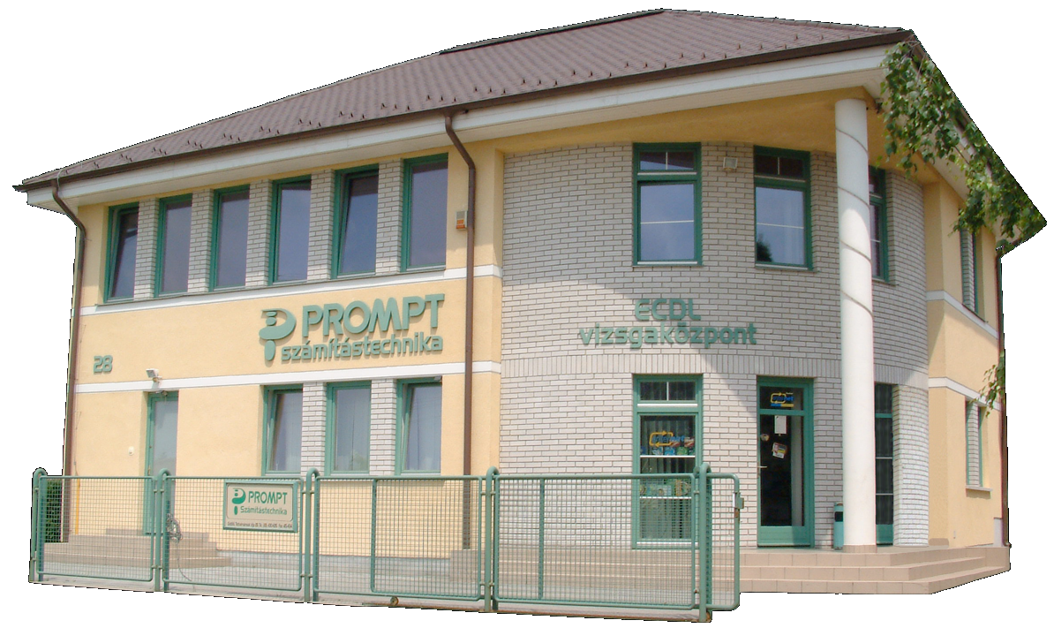
Gödöllő
Since 1989

Slide 3
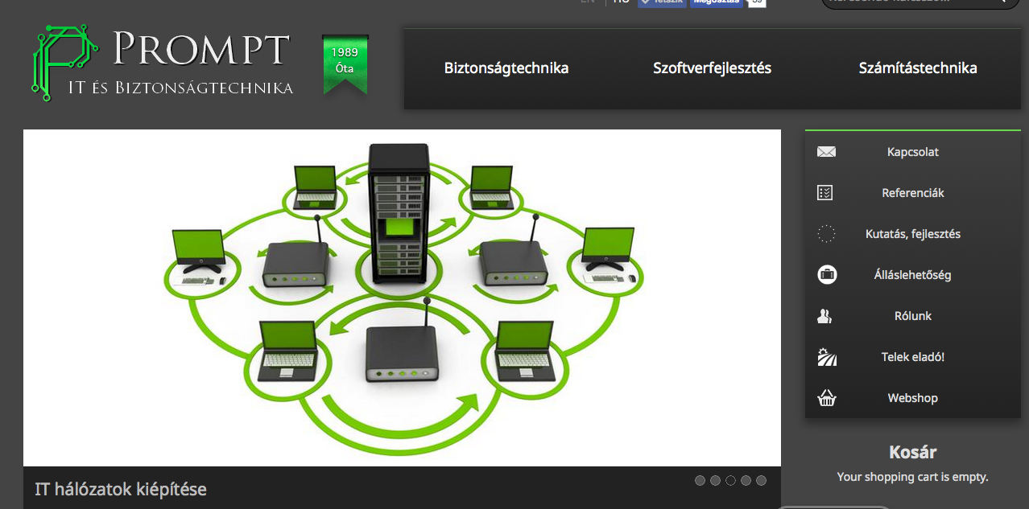
Notes:
Main divisions are working with multinational companies, mostly located in Gödöllő or very near to our city. Teva, caterpillar, gsk
(1) IT system integrations, security systems, IT services ()
(2) Adult education: IT trainings for employees, managers of enterprises, vocational educational courses, further trainings for teachers – and take part in Erasmus+ programmes

Slide 4
Development
Research
Adult Education

Slide 5
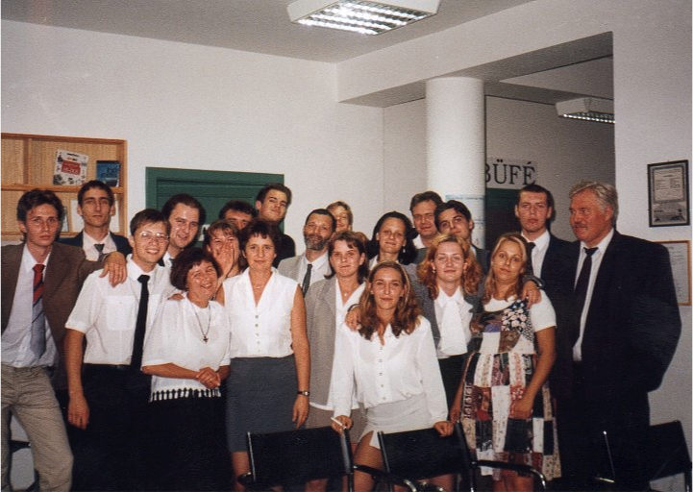
Thank you for your attention!
Adult Education
Delivering contact and online training
Teachers’ further training
Vocational Education IT Courses

Slide 6
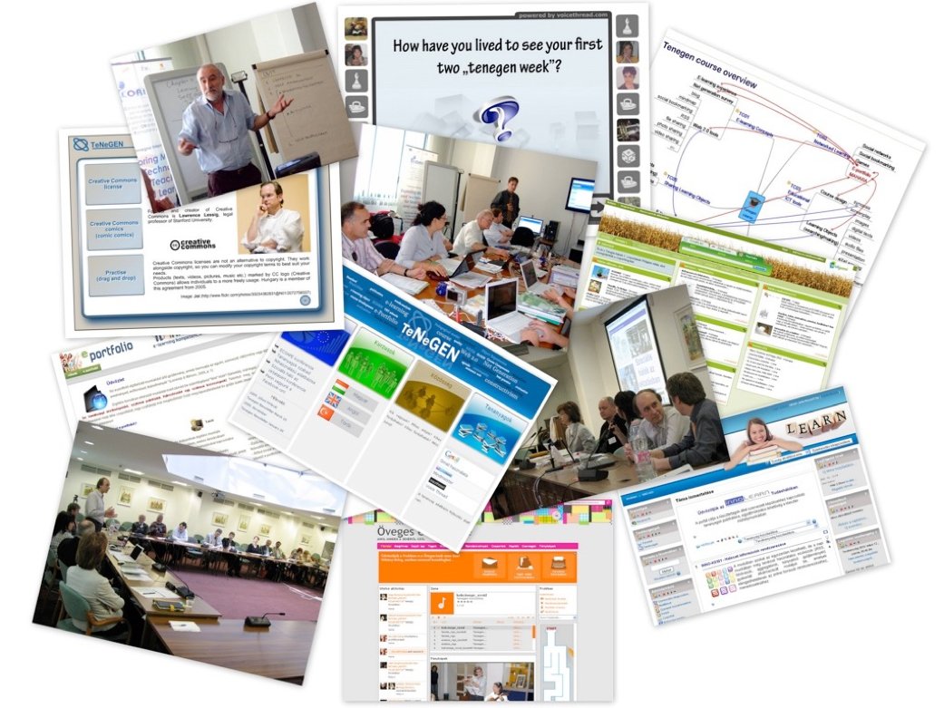
Thank you for your attention!
Technology Enhanced Learning
Education for 21st century
ICT-based Methods & Tools
Research

Slide 7
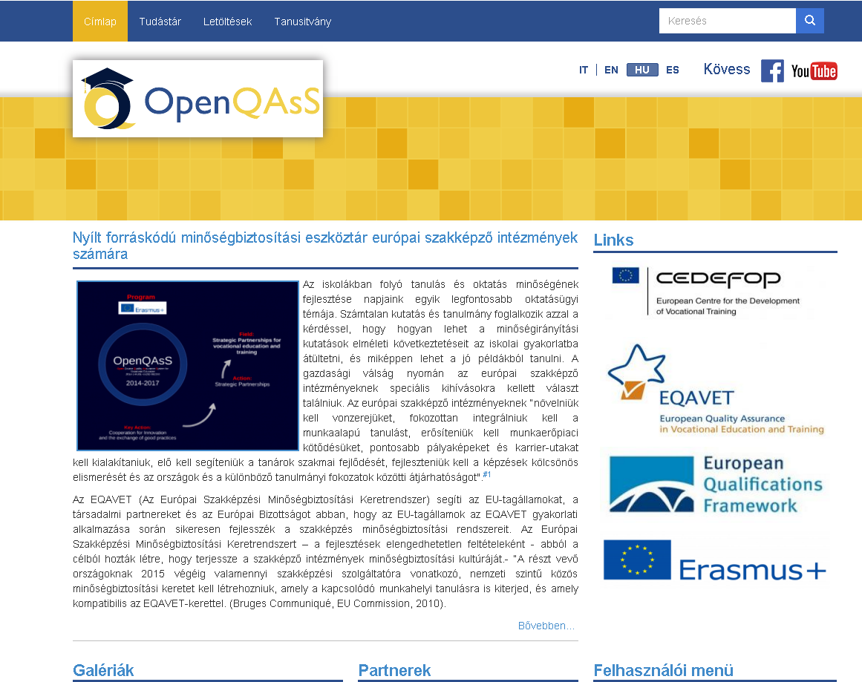
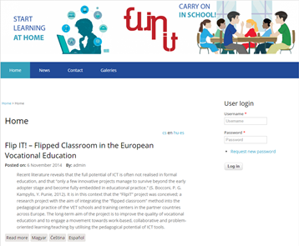
Thank you for your attention!
Curriculum Development
E-learning Solutions
Digital Learning Content
Educational Software
Developments
http://flip-it.hu

Slide 8
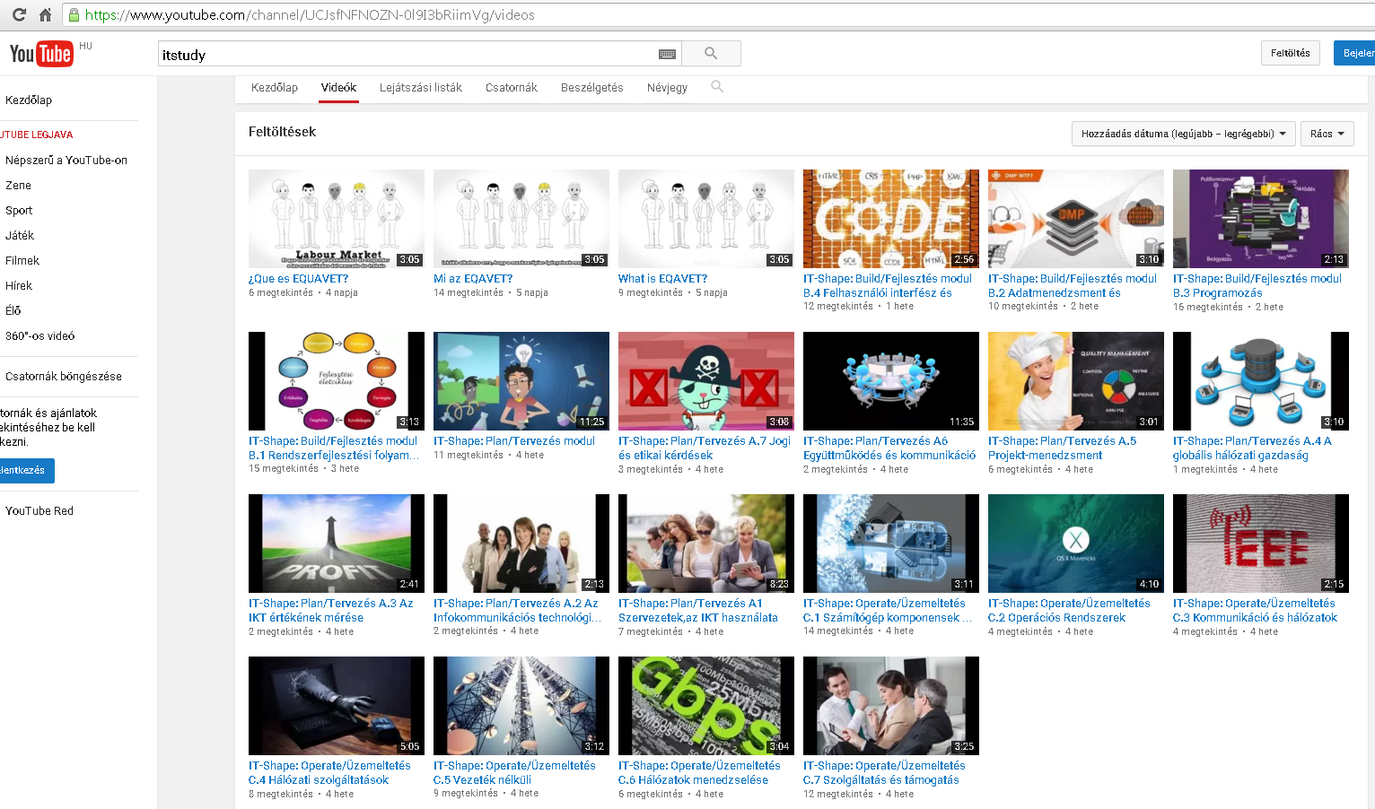
Youtube channel / iTStudy

Slide 9
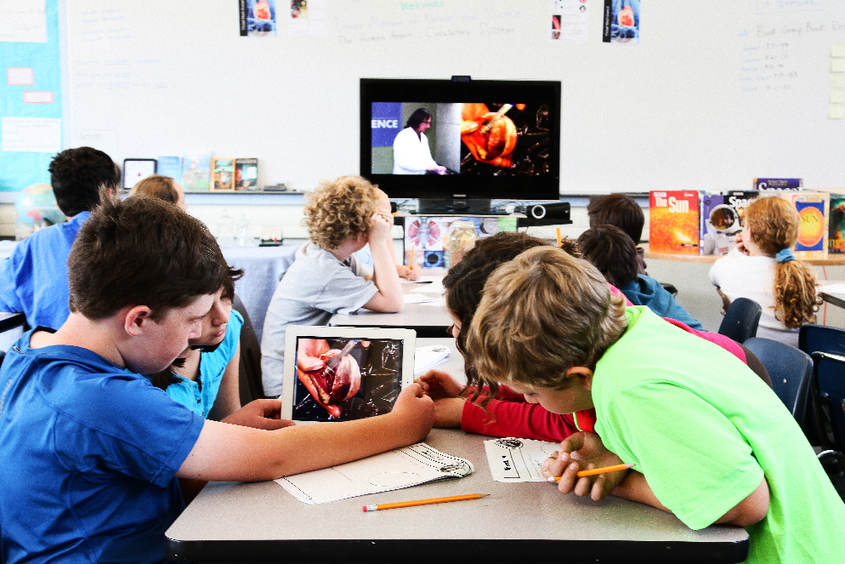
Thank you for your attention!
Developments
Research
Adult Education
… all around Education and ICT

Slide 10
Technology
Enhanced Learning
elearning
Notes:
One of the main field of developments is the TEL, eLearning solutions.

Slide 11
2015/2018
Projects
2014/2017
2013- 2015
2012-2014
TÁMOP 2.1.2
2011-2013
2011
TEACH®
Project Based Learning
2008-2010

Slide 12
… and at last but not least we are strong in Project Management …

Slide 13
János Szabó – iTStudy Hungary Ltd. janos.szabo@itstudy.hu
1st Project Meeting
Gödöllő, 11-12. September 2017

